Slide 1
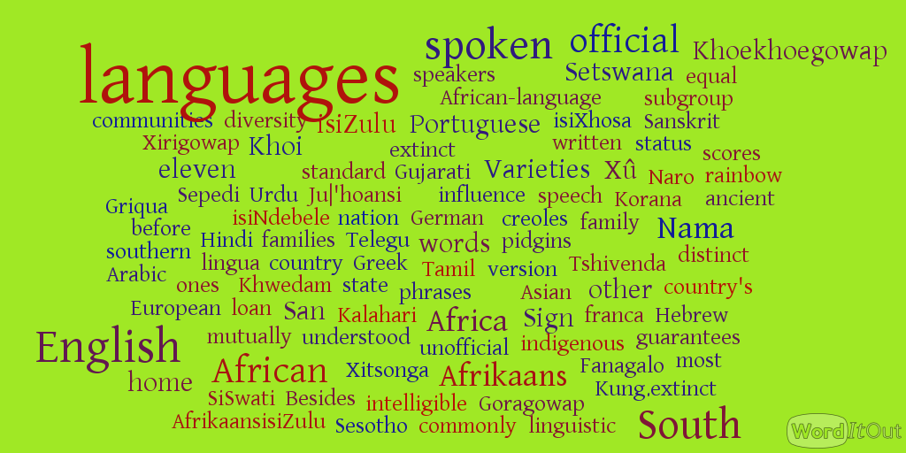

Slide 2
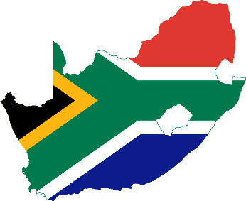
Language use and language attitudes in multilingual and multi-cultural South Africa
Moyra Sweetnam Evans, University of Otago,
New Zealand

Slide 3
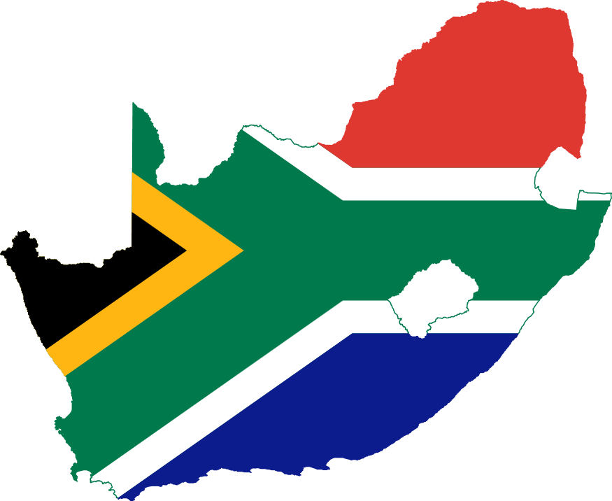
Bonjour
Sanibonani (Zulu, Swazi)
Molweni (Xhosa)
Dumelang (Sotho, Tswana)
Avuxeni (Tsonga)
Goeie more (Afrikaans)
Good morning (English)
Thobela (Pedi – N. Sotho)
Ndaa (Venda)
Lotjani (Ndebele)

Slide 4
Other languages
Khoisan (Nama, Griqwa & others)
Indian languages (Urdu, Guajarati, Hindi, Tamil)
European languages (Portuguese, Greek, French, German, Dutch, Bulgarian, Croatian, Spanish, Italian ...)
Other African languages – recent immigrants

Slide 5
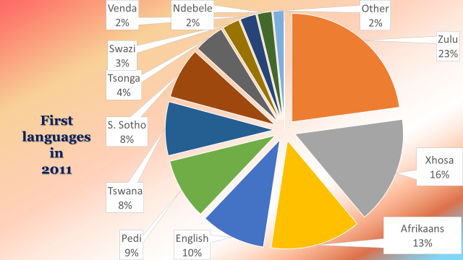

Slide 7
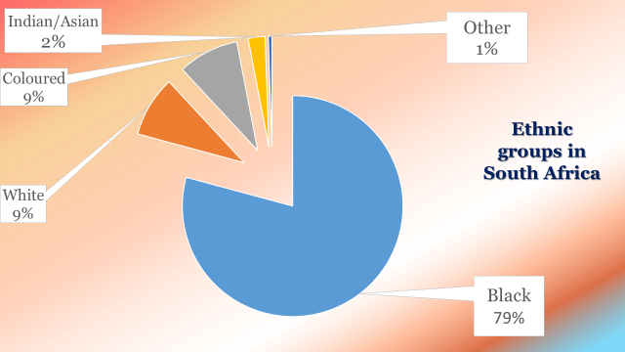

Slide 8
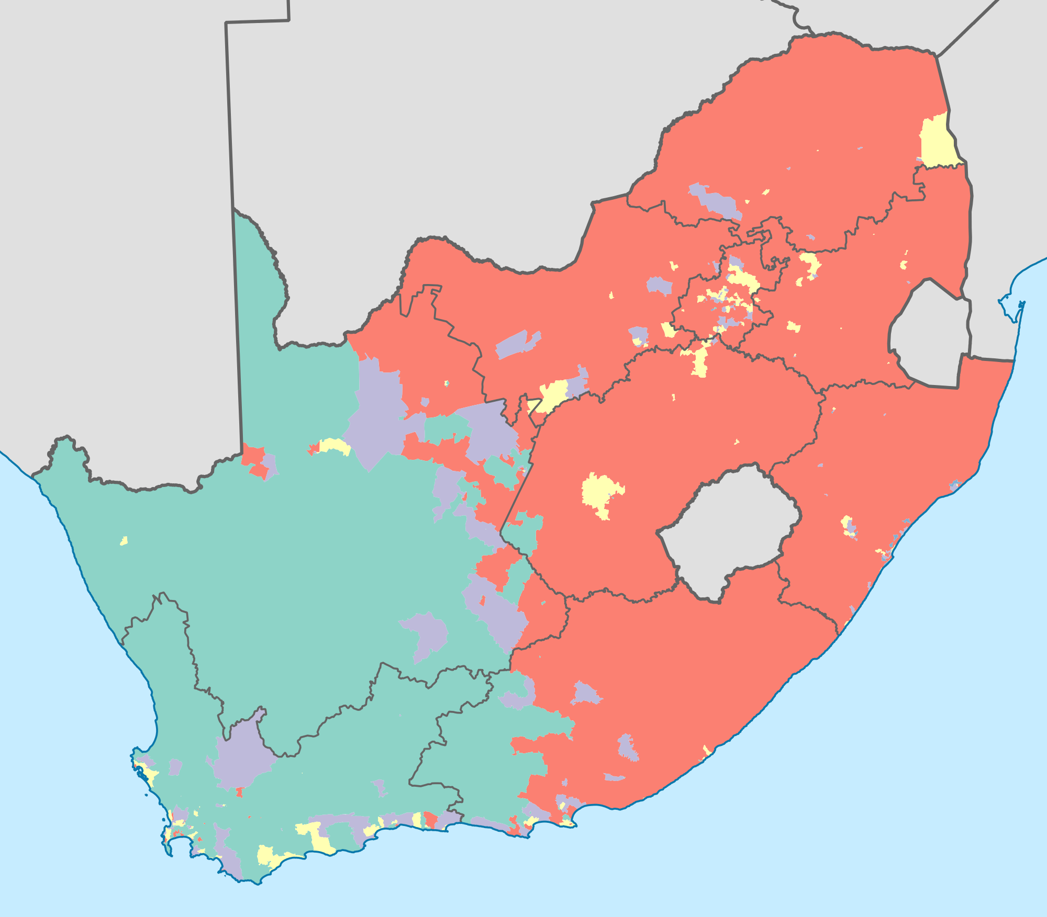
Dominant population group (race) by ward, 2011 Census
salmon: Blacks
green: Coloureds
beige: Whites
blue: Asians

Slide 9
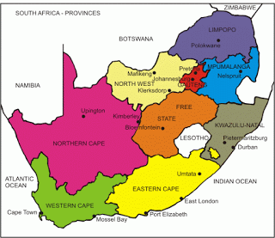
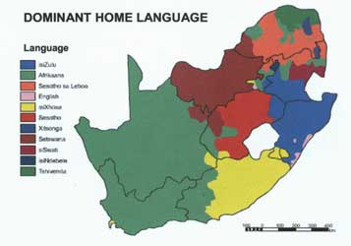
Distribution of first languages
Nine provinces

Slide 10
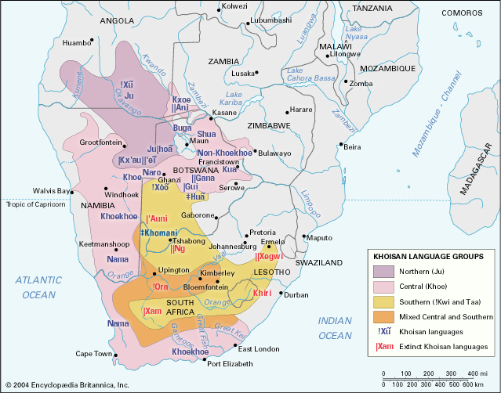
Khoisan
languages

Slide 11
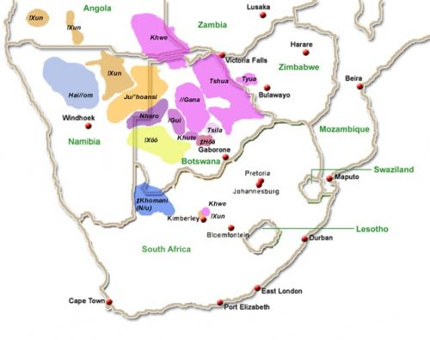
San Bushman
languages

Slide 12
Post-apartheid South African constitution -1996
promotion of multilingualism
enhancement of the status and use of South African indigenous languages
two existing official languages
  English, Afrikaans
nine new official languages added
  Zulu, Xhosa, Swazi, Ndebele, Northern Sotho (Pedi), Southern Sotho, Tswana, Venda, Tsonga

Slide 13
Changes in language use
Constitution (1996) aimed to protect and
enhance status of all languages
In last 20 years English more dominant
  government & public service
  education (more schools use English as language of learning/instruction)
  business
  advertising & packaging
  media
  lingua franca – among Blacks and among Blacks & Whites
  home (more parents are speaking it to their children)

Slide 14
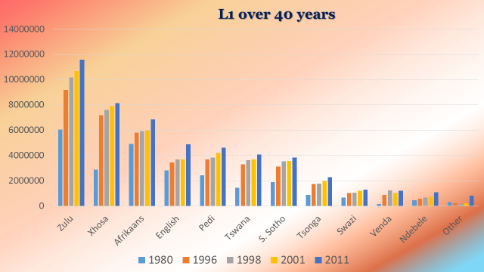

Slide 15
Change in L1 speakers over 10 years
2011 2001
Zulu 23.8% 22.7% -1.1%
Xhosa 17.6% 16% -1.6%
Afrikaans 13.3% 13.5% +0.2%
N. Sotho 9.4% 9.1% -0.3%
English 8.2% 9.6% +1.4%
Tswana 8.2% 8% -0.2%
S. Sotho 7.9% 7.6% -0.3%
Swazi 2.7% 2.6% -0.1%
Tsonga 4.4% 4.5% +0.1%
Venda 2.3% 2.4% +0.1%
Ndebele 1.6% 2.1% +0.5%
Other 0.5% 1.6% +1.1%

Slide 16
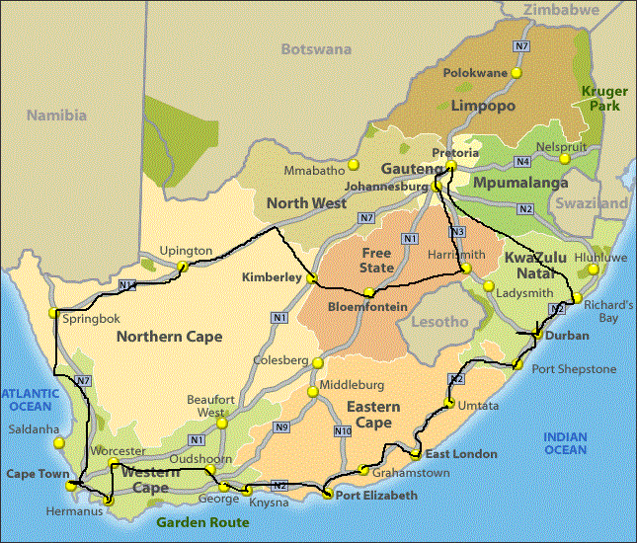
What are the language attitudes of people round the country 20 years after the end of Apartheid?
How do they use their languages?
February to March 2014
7500 km
6 of 9 provinces
33 focus groups

Slide 17
Methodology
University of Otago ethical approval
convenience sampling
approximately 200 participants (about 7 per group)
M, F, 14 to 90 yrs. education: nil to Ph.D.
working class to professionals
L1 speakers variety of languages
all know and use more than one language
Notes:
University of Otago ethical approval
variant of convenience sampling (Tracy, 2013)
participants not known to researcher
voluntary participation
conducted in English and/or Afrikaans
approximately 200 participants (about 7 per group)
M, F, 14 to 90 yrs. education: nil to Ph.D.
working class to professionals
L1 speakers
from most of the eleven official languages
from other (N/u; Guajarati, Spanish, German, Italian, Greek)
from all ethnic groups (White, Black, Coloured, Indian, Koisan)
all know and use more than one language

Slide 18
Focus group research
Benefits
relatively naturalistic settings
  koek en tee, social activity
  participants conversed freely
  more information
Variety of topics
Discussions were guided by focus group questions, covered other ground too.
Notes:
Benefits
relatively naturalistic settings
koek en tee, social activity, invited by host/hostess, some participants knew one another
participants conversed freely, told anecdotes, joked, exchanged opinions, agreed, disagreed
provided more information than could be expected from questionnaires or individual interviews
Topics
daily language use, language preferences, factors influencing language choices, code-switching habits, benefits of multilingualism and multiculturalism, language-in-education policies, predictions for the long-term future of languages, personal linguistic & cultural experiences

Slide 19
Preliminary findings
Language practices & home languages
Language preferences – English “advantage”, dominance of English
Language avoidance
Language attitudes
Language and identity
Negative aspects of living in a multilingual/multicultural society
Positive aspects of being multilingual

Slide 20
Individual language practices
Everyone is bilingual or multilingual
2 or 3-9 languages
Television – “soapies” and sitcoms, news
Newspapers & magazines
Other
Notes:
Most South Africans speak/use more than 1 language
Many Black South Africans use 3 or more languages
Some participants know 6 (English, Afrikaans, Xhosa, Tswana, Sotho, Zulu)
Many English speakers watch Afrikaans “soapies” and sitcoms (or ones with a great deal of code-switching), daily
Some Afrikaans-speakers don’t like the way Afrikaners are portrayed as crass and common and uneducated in the soapies (F, 50s, W, KZN)
Some English speakers watch news in English and Afrikaans and vice versa
Some (not many) English speakers read Afrikaans newspapers
Educated Afrikaans speakers read English newspapers, magazines & novels
Many Afrikaans participants volunteered swearing – L2 (E) & L1
Many Afrikaans participants volunteered praying – L1 & some L2 (E)
Educated Black South Africans read English newspapers & magazines

Slide 21
Home languages
Spousal choices
Parent choices
  parent language(s)
  English
Sibling choices
Notes:
Language of husband determines (F, 80s, W, WC)
or not: Two languages (mother’s & father’s)
Parents speak English & Afrikaans to children (F, 30s, W, FS) but give up when they perceive children “struggling”
Other parents persist with English & Afrikaans to children (F, 60s, W, KZN) (F, 40s, W, FS)
Most Black parents speak L1 with children (F, 20s, B, FS). I would feel like a traitor if I didn’t speak Zulu to my children (M, 20s, B, EC).
Black parents speak L2 English with children. Nannies speak heritage language with children (F, 30s, B, G)
Siblings choose their language of communication (F, 60s, W, KZN)
I speak English to my sister who can’t speak Zulu well because she went to a Model C school (M, 20s, B, EC/G)

Slide 22
Whites learning African languages
Early acquisition in childhood
Late acquisition
Much interest expressed
Sceptism amongst Blacks
Notes:
Whites raised on farms can generally speak a Black language
My father learned Zulu at university because he intended setting up a medical practice in Eshowe (M, 20s, W, EC)
Some Whites actively learning a new African language, because of moving to a new area, starting a new job, etc. (e.g. M, 60s, W, EC)
Many Whites want to learn an African language – usually the one spoken by Blacks in the province or area (I think that it would be more useful if I could speak one of the black languages fluently. Zulu or Xhosa or something like that) (F, 30s, C, NC) . (As jy kan Xhosa of Zulu ook verstaan, dan maak dit jou taak soveel makliker) (M, 40s, W, NC)
Some Black people are sceptical about how genuine this is – (the Whites don’t seem to be making much effort to learn our languages, despite what they say) (F, 20s, B, EC). Mirrored here (… (as) n mens ‘n geleentheid kan kry om Xhosa te leer …) (F, 40s, W, NC) – awaiting v. making opportunity
But at least many Whites are now recognising that they should really know some African languages

Slide 23
The English “advantage”
Acknowledged instrumental value for all groups
Lingua franca
  for White Afrikaners, Coloured Afrikaners, Blacks
English schools
Notes:
Instrumental value: English opens doors (M, 30s, W, EC)
English is the lingua franca, required to communicate in many domains (Engels sal jou die pad oopmaak omdat dit ‘n wêreld ding is) (F, 70s, W, NC)
Afrikaans children have attended English schools, since the 1950s (I was sent to an English school so I could go to and English University which was in the same town) (M, 60s, W, WC). Parents spoke Afrikaans at home.
Afrikaans parents speak L2 English to children (F, 60s, W, KZN)
Increasingly, Black children attend English medium schools (Model C)

Slide 24
Dominance of English
More English in workplace
More English in public places
Greater English required
Resentment
But also accommodation
Notes:
More English in workplace (Oorals waar jy tog kom praat die mense meeste van die tyd Engels. Ons papierwerk, ons dokumente wat ons ontvang is Engels) (M, 40s, W, NC)
Individuals are forced to extend their English competence (Ek moet nou al woordeboeke te gekoop het om daardie Engelse woorde te verstaan) (M, 40s, W, NC)
Resentment (W & C) – prof. dev. in English lingua franca, because of B. person who doesn’t understand or want to speak or learn in Afrikaans (Hulle neem nie die nege en dertig mense in ag wat wel Afrikaans praat nie, hulle neem die een persoon in ag wat Engels praat) (F, 40s, W, NC)
But – If there are 100 Xhosa speakers and one English speaker who can’t speak Xhosa, they’ll all speak English (M, 60s, W, EC)

Slide 25
Language avoidance
Avoiding Afrikaans
Avoiding English
Avoiding own L1
Notes:
Avoiding Afrikaans
It’s the language of the oppressor … I pretend I can’t understand it if someone speaks it to me (M, 20s, B, EC).
Hulle maak of hulle nie verstaan nie (F, 40s, W, NC)
I think with English in this country is a lot of snobbery about talking Afrikaans. A lot of them go to school and do matric in … Afrikaans and suddenly they lose the capacity. I think it’s bloomin’ snobbery. (M, 60s, W, WC)
Afrikaans as a lingua franca only (I speak Afrikaans to my servants only) (F, 50s, W, FS)
Avoiding English
In commercial transactions (My geld praat Afrikaans) (M, 60s, W, G)
Avoiding own L1
Moenie daai lelike taal in my huis of op my werf praat nie (to a N/u speaker)

Slide 26
Conflicting language attitudes
English-Afrikaans rivalry
Coconuts
Twanging
Model Cs
  Perceived arrogance of different groups
Notes:
English-Afrikaans rivalry Afrikaans is not a language it’s a throat disease (M, 20s, W, EC) (1970s)
(Would you like to improve your Afrikaans? “Never!”) (F, 50s, W, FS)
despite more use of both languages. (Ons moet soms ook Russies praat) (M, 50s, W, FS).
My Afrikaans family feel I shouldn’t be studying English (F, 20s, W, EC)
Resentment of young Black people who speak English with “White” accents – “coconuts who twang” (F, 20s, B, EC), “model Cs” (F, 20s, B, KZN)
In KZN many 30 to 40-year olds insist on speaking Zulu – it’s very arrogant (F, 50s, W, KZN)
Xhosas are the least accommodating … they will not answer a Black person in any language other than Xhosa. Zulus are more accommodating (M, 20s, B, EC)

Slide 27
Language & identity – cultural perceptions
Afrikaner vs. English-speaker perceptions
Young Black people moving away from traditional culture
Notes:
Afrikaners generally see few differences between them and English-speaking Whites. (… in South Africa … Afrikaans, (and) English have got more or less the same culture) (F, 70s, W, WC)
English-speaking Whites feel the opposite. (If you grow up in two cultures it can cause an identity crisis … I grew up English-speaking in an Afrikaans area and you were kind of caught between the two a little bit) (M, 30s, W, WC). They (Afrikaners) are aliens. (M, 40s, W, FS)
Young Black people moving away from traditional culture. (I can’t identify with my grandparents’ cultural practices, … going topless for cultural ceremonies) (F, 20s, B, FS). I’m being distanced from my Zulu culture … it takes me a few days to acclimatise when I go back to Soweto (from Grahamstown) (M, 20s, B, EC). Spending too much time in another culture makes you lose your roots over time (M, 20s, B, EC)

Slide 28
Negative aspects of multilingual society
Frustration
Miscommunication
Expense
One language and culture starts to dominate
Notes:
Dit lei tot frustrasie as julle nie mekaar se taal kan praat nie. (F, 50s, W, NC)
Most people believe interpreters are necessary: e.g. a patient ingesting suppositories because English instructions not understood (F, 20s, C, NC)
South Africa has too many official languages. It’s simply impractical with 11 official languages. Would be better with 5. (F, 60s, W, WC)
Too expensive to have interpreters in all languages in all public spheres (police stations, hospitals, courts)
Too expensive to have L1 instruction in all schools, even regionally
One language and culture starts to dominate (We have to go back to isiXhosa, polish it up and make it attractive. English makes itself attractive, Xhosa must do so to begin growing again) (M, 30s, B, EC)

Slide 29

Despite everything, we code-switch
Spectrum of attitudes
  Use “pure” language
  Professed abhorrence but still it is used
  Accepted in spoken language
  Accepted as natural
  Championed as truly South African
Notes:
My Afrikaans teacher in the Free State always said; “As jy Afrikaans praat dan praat jy suiwer Afrikaans” and it’s stuck with me, but every now and again it’s nice just to switch over (M, 60s, W, WC)
I hate it. I can’t stand it when people just gooi the other language in (F, 40s, W, G)
Its kak that my kids have to learn Afrikaans at school (M, 40s, W, WC)
Shouldn’t be done in formal English (M, W, 60s, WC)
It’s okay to mix languages if you know when to do it …
even fine in writing in appropriate articles e.g. last
page in certain magazines (F, W, 50s, KZN)
Cool, a natural process, brilliant, adds colour,
reflects the change in attitude of people in SA (EC)
Sign:
http://www.meetup.com/saffasclub/ accessed 29 October 2014and use of (often together)

Slide 30
Positive aspects of being bilingual/multilingual
Making contact
Showing respect, gaining respect
Strategic asset
Making friends
Winning people over
Being “colourful”
Notes:
One immediately has contact with a person if you can speak his or her language (M, 30s, W, WC)
As jy ‘n persoon aanspreek in sy taal, het hy baie meer respek vir jou (F, 40s, W, NC)
It’s a strategic asset to be able to communicate with people in their native language (i.e. business purposes, international trade, etc.) (M, 30s, W, WC)
It’s a great way of making new friends (M, 60s, W, WC)
I grew up in a home where my mother spoke Zulu fluently and when we were in trouble as a family, a flat tyre in a rural road and you feel unsafe, but you speak Zulu and suddenly you have lots of friends (M, 60s, W, WC)
… in any language if you can say a few words you win people over and they open up to you (F, 60s, W, WC)
Multilingualism is colourful (F, 60s, W, WC)

Slide 31
Siyabonga
Ke a leboga
Enkosi
Dankie
Thank you
Je vous remerci

Slide 33
References
Billson, J.M. (2006). Conducting focus group research across cultures: Consistency and comparability. WeD Working Paper 27. Bath, U.K.: Economic & Social Research Council.
Crystal, D. (2003). English as a Global Language. 2nd Edition. Cambridge: Cambridge University Press.
Lubbe, J. & Du Plessis, T. (2013). South African Language Rights Monitor 2009. Eighth report on the South African Language Rights Monitor Project. Bloemfontein: Sun Press.
Morgan, D.L. (1997). Focus Groups as Qualitative Research. Thousand Oaks: Sage.
Posel, D. and Casale, D. (2011). Language proficiency and language policy in South Africa: Findings from new data. International Journal of Educational Development 31, 449–457
Republic of South Africa. (1996). Constitution of the Republic of South Africa. Government Printer, Pretoria.
Statistics South Africa. (2012). Census 2011 Census in brief . Pretoria: Statistics South Africa, Report 03-01-41.
Tracy, S.J. (2013). Qualitative Research Methods: Collecting evidence, Crafting Analysis, Communicating Impact. Chichester: Wiley-Blackwell.

Slide 34
Acknowledgements for images
Image for dominant home language http://www.oulitnet.co.za/taaldebat/smag.asp accessed 29 October, 2014
Image for dominant population group by ward http://welections.wordpress.com/guide-to-the-2014-south-african-election/race-ethnicity-and-language-in-south-africa/ accessed 28 October 2014
Image for San languages http://www.kalaharipeoples.net/uploads/photos/South%20African%20San%20copy.jpg accessed 29 October 2014 accessed 28 October 2014
Image for South African provinces http://southafricamaps.blogspot.co.nz/2013/11/south-africa-map-provinces-pictures_18.html/ accessed 29 October 2014 accessed 28 October 2014

